Slide 1
DIP Project Final Presentation Team Bellissimo
Project: Weak-Light Image Enhancement Method Based on Adaptive Local Gamma Transform and Color Compensation
Team Members: Ainesh Sannidhi, Anandhini Rajendran, Kunwar Maheep Singh, Mayank Jain
TA: Haripraveen Subramanian

Slide 2
Project ID: 14
Github Link: https://github.com/Digital-Image-Processing-IIITH/dip-project-bellissimo

Slide 3
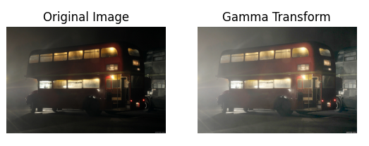
Weak Light Image Enhancement Using Adaptive Gamma Transform
Trivially, gamma transform has been used to enhance low light images, however for images with uneven illumination, a uniform gamma transform will lead to over-saturation in some part of the image and under-saturation in others.

Slide 4
Illumination-Reflection Model
In the illumination-reflection model, the brightness of any pixel in the image can be considered a product of its illumination component(I) and the reflective component(R).
F(x, y) = I(x, y)*R(x, y)
The illumination component spectrum is usually concentrated in a low frequency region which reflects the lighting environment during image capture. If this can be extracted from the image and made even, then the effect of uneven lighting can be removed from the image.

Slide 5
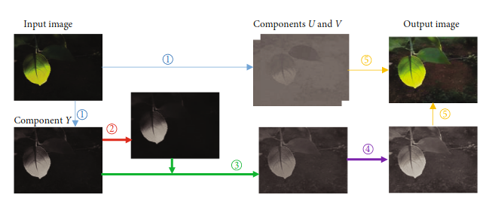
Steps for Weak Light Image Enhancement
Conversion from RGB to YUV space
Extraction of illumination component using fast guided filter
Local gamma transform
Grayscale linear stretching
Color compensation

Slide 6
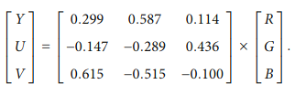
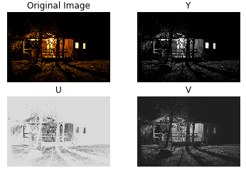
Conversion from RGB to YUV Space
Human eyes are more sensitive to luminescence than color. This information cannot be captured effectively in RGB space and therefore we work in the YUV space where each color corresponds to two chrominance components(U, V) and one brightness component(Y).

Slide 7
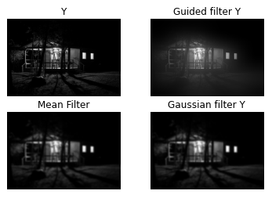
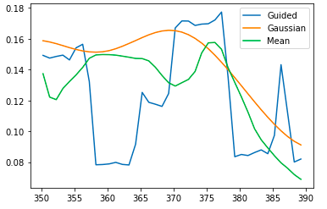
Extraction of Illumination Component Using Fast Guided Filter
We need to extract the illumination component from a scene to correct the effect of uneven lighting. Many different algorithms were considered such as mean filter, gaussian filter, bilateral filter.

Slide 8

Guided Filter
Mean and gaussian filters did not do a good job of preserving the original image and using a bilateral filter for edge preservation was not computationally feasible. Finally, fast guided filter was chosen as it was both fast and edge preserving.
Steps:
Here for input image ‘p’, output image ‘q’ and guide ‘I’, for every pixel ‘s’ we have:
Where ‘j’ is the pixel index and ‘a_{s}’ and ‘b_{s}’ are linear transform factors.

Slide 9
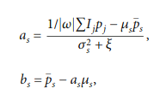
Steps for Guided Filter
The reconstruction difference between ‘p’ and ‘q’ is minimized for the following choice of ‘a’ and ‘b’:
where sigma_{s} and mu_{s} are the variance and the mean value of the guided image ‘I’ within the window omega_{s}, respectively;
‘ξ’ is a parameter that controls the degree of smoothness of the filter. |ω| the pixel number of ‘s’; and ‘p_{s}’ is the mean value of the input image ‘p’.

Slide 10
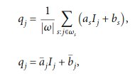
Steps for Guided Filter
This gives output:
where ‘a_{j}’ and ‘b_{j}’ are the mean values of ‘a’ and ‘b’, respectively, within the neighborhood window omega_{s} centered on pixel ‘j’.

Slide 11
Notes for Guided Filter
In the paper, the guidance image was not specified, neither was a standard given to choose the parameter ‘ξ’.
After reading about self guided filter and using some hints from the flowchart in the paper, we assumed the guide to be the image itself and ‘ξ’ to be the standard deviation of all the pixels in the image.
Instead of multiscale illumination which is the weighted mean of guided filters with different window sizes, single scale illumination was chosen for computational benefit with window size as floor(min(h, w) / 4) where ‘h’, ‘w’ are the dimensions of the image.

Slide 12

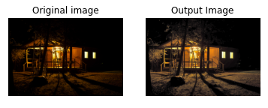
Local Gamma Transform
We choose γ = m^{2G(x, y) - 1} where G(x, y) is the illumination extracted component. For images with excessively high contrast, a ‘γ’ value greater than 1 should be adopted, i.e., the value of ‘m’ should be low, to suppress the illumination intensity. As such, an adaptive brightness adjustment function based on local gamma transformation was proposed -

Slide 13
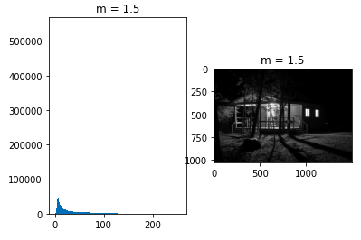
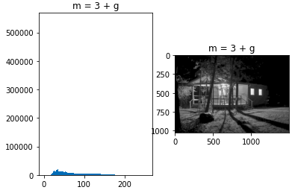
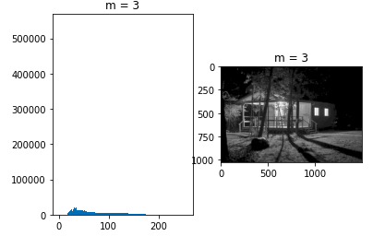

Result for Different ‘m’ Values

Slide 14

Grayscale Linear Stretching
We use simple linear stretching to include the entire grayscale range.
where Y’ is the Y component after local gamma transform.

Slide 15
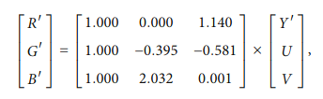
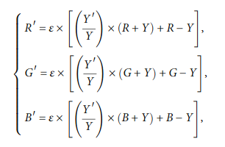
Color Compensation
The YUV space is converted back to RGB using the following matrix:
After conversion, decrease in color saturation is fixed using the following transforms:
with e = 0.5

Slide 16
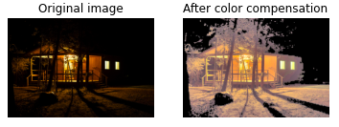
Issues with Color Compensation
In our tests this led to over-saturation of the images. The results are as follows:

Slide 17
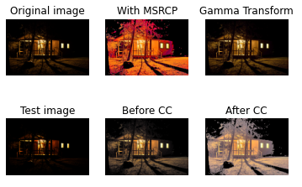
Results
Result 1:

Slide 18
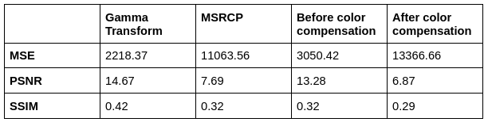
Results
Result 1:

Slide 19
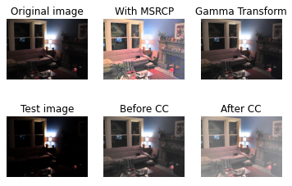
Results
Result 2:

Slide 20
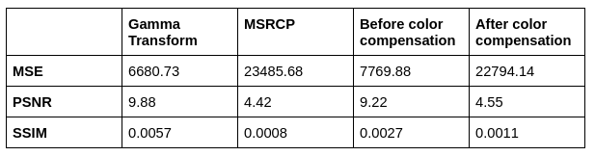
Results
Result 2:

Slide 21
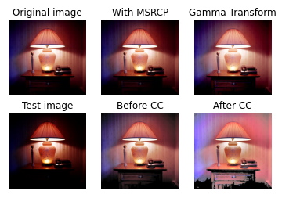
Results
Result 3:

Slide 22

Results
Result 3:

Slide 23
Application of Image Enhancement
Fingerprint recognition is a widely used biometric solution for authentication on computerized systems. The probability of two fingerprints matching is very small, around 1 in 1.9*10¹⁵. Image enhancement is one of the steps in fingerprint extraction. Here, we are replacing the image enhancement used in the paper Fingerprint Image Enhancement And It’s Feature Extraction For Recognition with Weak-Light Image Enhancement Method Based on Adaptive Local Gamma Transform and Color Compensation and comparing the results.

Slide 24
Steps in Fingerprint Feature Extraction
Image acquisition
Image enhancement
Image Binarization
Fingerprint Ridge Thinning
Feature extraction

Slide 25
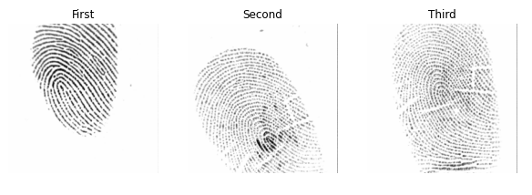
Image Acquisition
We are using the FVC2002 fingerprint dataset which is a Fingerprint Verification Competition dataset that was organized back in the year 2000 and then again in the year 2002. This dataset consists of four different fingerprint sensors namely Low-cost Optical Sensor, Low-cost Capacitive Sensor, Optical Sensor, and Synthetic Generator, each sensor having varying image sizes. The dataset has 3200 images in set A, 800 images per sensor.

Slide 26
Image enhancement
An enhancement algorithm's purpose is to increase the clarity of the ridge structures in recoverable parts while marking unrecoverable sections too noisy to process further.
We use two enhancement methods to compare the results:
Using Fourier domain filtering and histogram equalization.
Using Weak-Light Image Enhancement Method Based on Adaptive Local Gamma Transform and Color Compensation

Slide 27
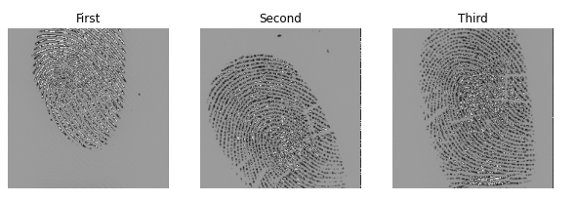
Method 1: Fourier Domain Filtering and Histogram Equalization
Fourier Domain Filtering: First, we split the image into frequency domain F (u, v) and multiply this frequency domain with a constant such as |F(u, v)|^k. After doing this, we take the inverse Fourier of this altered frequency domain to get the enhanced image.

Slide 28
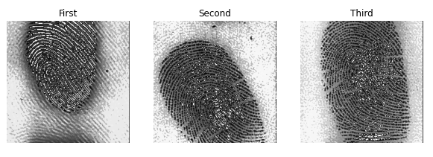
2. Histogram Equalization: Next, we apply histogram equalization to get the enhanced image.

Slide 29
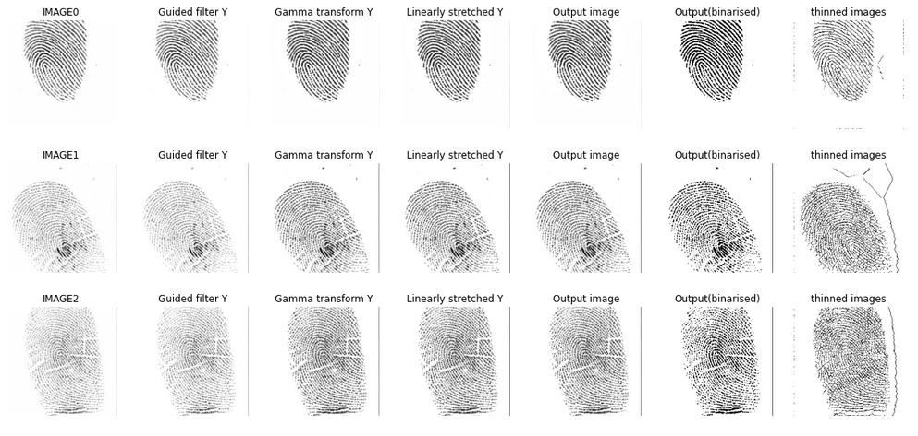
Method 2: Using Weak-Light Image Enhancement Method Based on Adaptive Local Gamma Transform and Color Compensation

Slide 30
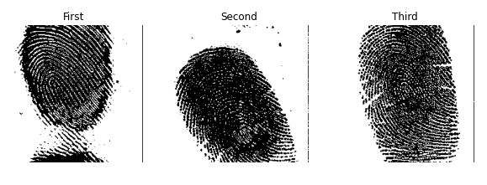
Image Binarization
In this process, we convert gray images to binary images. Most minutiae extraction algorithms operate on binary images where the black pixels represent ridges and the white pixels represent valleys. We use thresholding to convert it to a binary image.

Slide 31
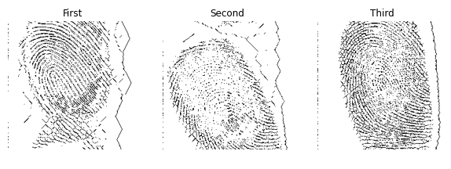
Fingerprint Ridge Thinning
The images obtained from method 1 need morphological operations such as erosion or dilation to obtain a thinned image. We use the process of skeletonization to obtain an image with 1-pixel wide lines.

Slide 32

Feature Extraction
The sum of 8 neighboring pixels is used to find the minutiae points.
sum = 6: rigid line
sum = 5: bifurcation
sum = 6: termination
The final feature space will contain all bifurcations and terminations. These are features required for fingerprint recognition.

Slide 33
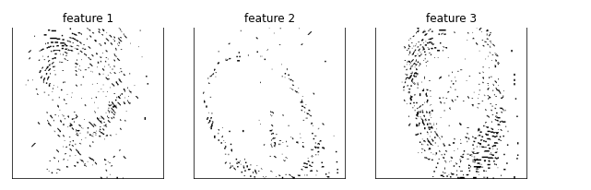
Features using Fourier Domain Filtering and Histogram Equalization

Slide 34
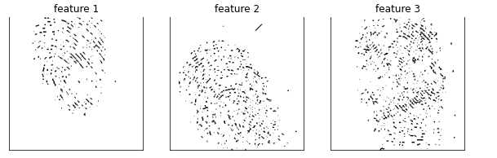
Features Method 2: Using Weak-Light Image Enhancement Method Based on Adaptive Local Gamma Transform and Color Compensation

Slide 35
Results
For the data tested, replacing Fourier domain filtering and histogram equalization with weak light image enhancement based on adaptive local gamma transform extracted better features and gave a more accurate skeleton.

